Slide 1
LoyaltyFi: The Universal Loyalty Point Exchange
Tagline: Tokenizing Loyalty. Unlocking Global Value.

Slide 2
The Problem
$200B+ in loyalty points go unredeemed every year
Points are siloed and non-interoperable
Consumers lack liquidity and control
Brands carry unredeemed points as liability
Governments have no visibility or control over this value layer

Slide 3
Our Solution
LoyaltyFi tokenizes and connects loyalty programs into a unified exchange:
Swap points across brands
Spend them like currency
Use as collateral, stake, or save
Plug-and-play for brands via APIs

Slide 4
Product Overview
ULTS: Universal Loyalty Token Standard
Consumer Wallet & Marketplace
Brand APIs/SDKs for easy integration
POS compatibility and compliance-first infrastructure
Insights dashboards for brands & governments

Slide 5
Market Opportunity
Global Loyalty & Rewards Market:
$500B+ in loyalty points issued annually
$200B+ go unredeemed (trapped value)
Loyalty Management Market: $10.8B in 2023 → $24B by 2029 (14% CAGR)
Airline programs like Delta SkyMiles valued at $26B (more than airline during downturn)

Slide 6
Competitive Landscape
Company | Interoperability | Tokenization | Marketplace | B2G Tools
Loyyal | ❌ Limited | ✅ Yes | ❌ No | ❌ No
KrisPay | ❌ Closed | ✅ Yes | ❌ No | ❌ No
TokenD | ⚠️ Partial | ✅ Yes | ⚠️ Partial | ❌ No
LoyaltyFi | ✅ Open Protocol | ✅ Yes | ✅ Yes | ✅ Yes

Slide 7
Business Model
1-3% fee on loyalty token exchanges
SaaS APIs for brands and partners
Premium features: portfolio tracking, smart conversion
B2G software for token-based subsidies or benefits
Loyalty staking/yield systems

Slide 8
Traction & Roadmap
Q2 2025 – MVP & early retail partners
Q3 2025 – Wallet & marketplace launch
Q4 2025 – Compliance, POS pilots
2026 – Global + Government partnerships

Slide 9
Team
Mihir Kavishwar – Founder
Tech sales @ MathWorks (Apple), ex-entrepreneur
USC Master’s, patent-backed products
Deep startup, AI, and blockchain exposure
Advisory board (coming soon)

Slide 10
Our Ask
$500K pre-seed round
Use of funds:
  40% Product
  30% Partnerships
  20% Compliance
  10% Ops
Goal: MVP + 10 enterprise integrations

Slide 11
Vision
Loyalty shouldn’t be locked.
We’re building the financial bridge between loyalty and utility.
Join us in reshaping how the world earns, trades, and spends value.

Slide 12
Visual Analogy: Interoperable Loyalty Flywheel
Diagram Description (for slide): A circular flywheel showing the mutual benefit cycle:
Brand A (e.g., Delta) → tokens accepted at Brand B (e.g., Starbucks)
Brand B → gains new customers, shares fees with Brand A
Customer → uses points freely across ecosystem → spends more overall
LoyaltyFi → earns transaction fees, feeds data insights back to brands
💡 Result: More engagement, more spend, less liability, better retention for all parties.

Slide 13
Visual Analogy: Interoperable Loyalty Flywheel
Diagram Description (for slide): A circular flywheel showing the mutual benefit cycle:
Brand A (e.g., Delta) → tokens accepted at Brand B (e.g., Starbucks)
Brand B → gains new customers, shares fees with Brand A
Customer → uses points freely across ecosystem → spends more overall
LoyaltyFi → earns transaction fees, feeds data insights back to brands
💡 Result: More engagement, more spend, less liability, better retention for all parties.

Slide 14
Why Would Brands Share Loyalty?
Common Concern: "Loyalty is meant to lock users in. Why allow point sharing?"
Our Response:
✅ New Acquisition → Points convert into customers from other brands
✅ Earn Commission on every swap or redemption
✅ Control Rules → Brands choose partners, exchange rates, limits
✅ Reduce Liability from unused points
✅ Gain Loyalty Data → Get insights on customer journey across platforms
Analogy: Like airlines selling miles to banks, you create new revenue streams — without giving up control.

Slide 15
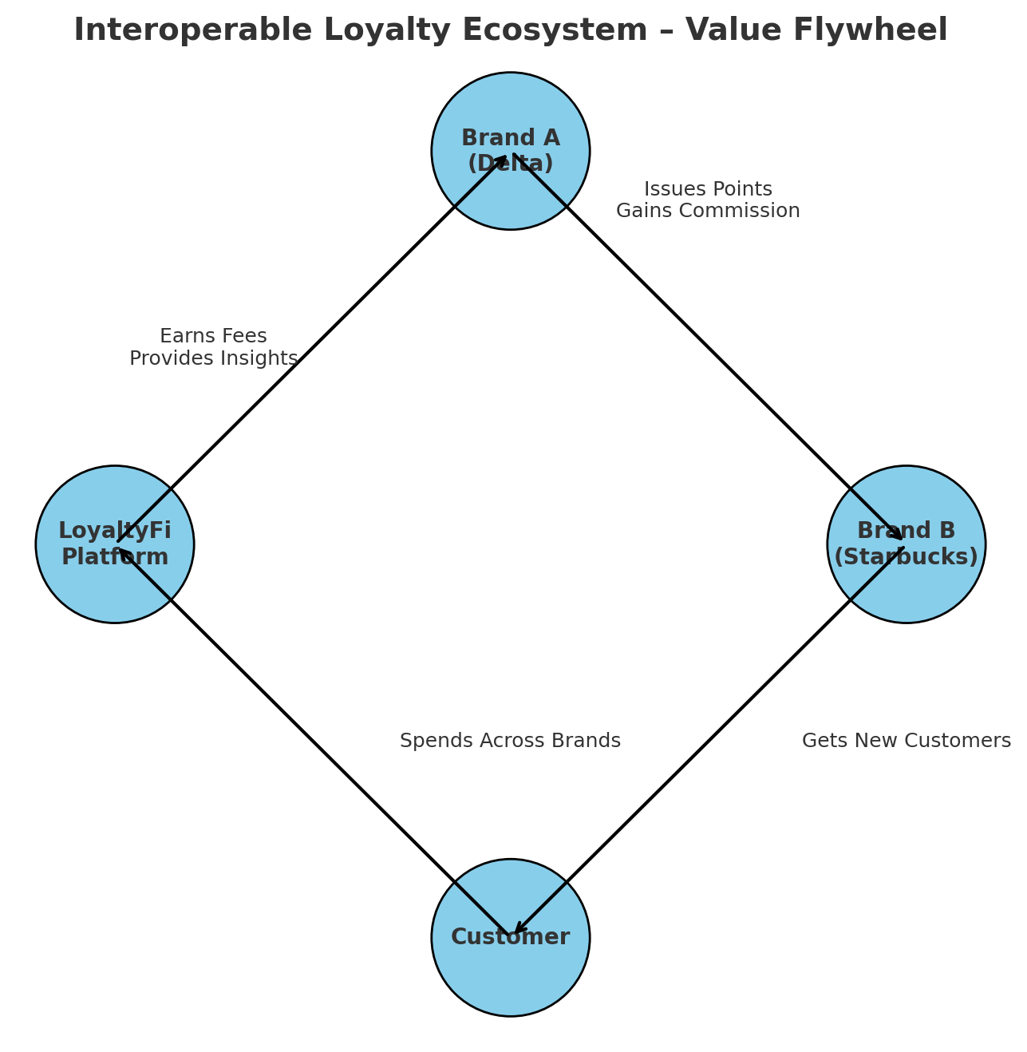

Slide 16
Why Brands Use Loyalty Programs
Retention is 5–7x cheaper than acquisition
Loyalty members spend 2–3x more per transaction
Enables behavioral and transactional data collection
Drives recurring revenue (e.g., points sold to credit card companies)
Encourages emotional and psychological stickiness (gamification, sunk cost effect)

Slide 17
Success Stories in Loyalty
Starbucks Rewards: 53% of U.S. store sales through program
Delta SkyMiles: $26B valuation
Marriott Bonvoy: $4.2B in loyalty revenue (2022)
Customers in programs show 2–3x higher spending rates and increased engagement

Slide 18
Future of Loyalty Programs Will They Continue to Exist?
Yes, but with evolution:
Consumers expect flexibility, transparency, and digital-first experience
Brands are pressured to reduce financial liabilities while increasing engagement
Emerging tech like blockchain enables programmable, interoperable loyalty models
Key Trends:
Tokenization of rewards
Real-time valuation and redemption
Interoperable ecosystems between brands

Slide 19
Threats to Legacy Loyalty Programs
Program fatigue and saturation
Devaluation risk (inflation of points)
Low redemption = poor engagement
Lack of liquidity
Regulatory changes (breakage liabilities, accounting pressure)
LoyaltyFi Response:
Real-time conversion & liquidity
Consumer trust through transparency
Ecosystem-wide utility across brands
Compliance-ready architecture

Slide 20
Why Governments Should Care?
Loyalty points represent a shadow financial system with limited traceability
Unredeemed points are a liability with no tax or audit trail
LoyaltyFi introduces traceable, tokenized rewards that support economic transparency
Opportunity to promote financial inclusion via loyalty-based micro economies
Integration with UBI, subsidies, carbon credits, or education rewards possible

Slide 21
Benefits for Governments
✅ Economic Visibility: Tokenized points become part of the traceable digital economy
✅ Regulatory Compliance: On-chain transactions provide auditability and reporting
✅ Welfare Distribution: Use loyalty tokens as rails for government incentives (e.g., food, transport)
✅ Financial Inclusion: Reach underbanked populations via mobile-based loyalty wallets
✅ Job & Growth Incentives: Encourage small businesses to participate in shared loyalty pools

Slide 22
Public Sector Use Cases
Education Vouchers: Token-based rewards for academic performance or attendance
Green Incentives: Earn tokens for eco-friendly behavior redeemable in partner networks
Healthcare Programs: Preventive care rewards usable for transport or healthy food
Tourism Boost: Localized tokens for regional travel, shopping, or cultural exploration

Slide 23
Government Integration Model
Partner with LoyaltyFi as a SaaS vendor for token infrastructure
Define reward criteria (behavioral, location-based, demographic-specific)
Distribute tokens via public apps or through retail partners
Monitor usage via compliance-ready dashboards and API integrations

Slide 24
What Customers Care About
🔄 Want flexibility: Use rewards across more brands
⏰ Hate point expiration and redemption delays
🧠 Forget where their points are or how much they’re worth
💸 Prefer cash value, gift cards, or crypto over brand-only perks
📲 Want everything in one wallet, not dozens of brand-specific apps

Slide 25
LoyaltyFi for End Users Title: LoyaltyFi = Freedom + Utility
One wallet to track all points
Convert hotel points to coffee, miles to groceries
Real-time dollar value estimates for all loyalty tokens
Auto-notifications for expiration and swap suggestions
Mobile-first experience, no new cards or logins

Slide 26
Customer Insights & Trends
75% want cross-brand loyalty use
2 out of 3 Gen Z prefer rewards in cash or crypto
60% say flexibility is more valuable than big bonuses
Most customers would engage more if rewards were visible and usable across apps

